Slide 1

WELCOME

Slide 2


0/1 Knapsack Using Dynamic Programming And Fractional Knapsack Using Greedy Algorithm
NAME-VRAJ PATEL
ROLL NO-10
ENROLL NO-2021002170110123
NAME-MANAV BHAVSAR
ROLL NO-5
ENROLL NO-2021002170110009
NAME-NILAY RADHANPURA
ROLL NO-12
ENROLL NO-2021002170110147
NAME-DIVYESH GURJAR
ROLL NO-17
ENROLL NO-2021002170110041

Slide 3
INTRODUCTION
The Objective Of The Knapsack Problem Is To Maximize The Sum Of The Profits Of The Items Selected In Knapsack With Sum Of Weight Less Than Or Equal To Knapsack’s Capacity
0/1 Knapsack Problem Means That The Items Are Either Completely Or No Items Are Filled In Knapsack
Fractional Knapsack Problem Means That Items Can Also Be Taken In Parts That Is Items Can Also Be Broken To Maximize The Profit

Slide 4
0/1 KNAPSACK USING DYNAMIC PROGRAMMING
IF THERE ARE N ITEMS WITH THE WEIGHTS W1,w2,w3..Wn And Values(profit) V1,v2,v3..Vn And Capacity W
We Have To Find Most Suitable Subset Of The Items That Fit Into The Knapsack And Gives Maximum Profit
Time Complexity 0(nw)
Where N->no Of Items W->capacity Of Knapsack

Slide 5
RECURRENCE RELATIONS TO SOLVE THE PROBLEM(FORMULAS)
TABLE[i,j]=MAX(TABLE[i-1,j],Vi+TABLE[i-1,j-wi]) IF j>=wi
TABLE[i,j]=TABLE[i-1,j] if j<wi
TABLE[i,0]=TABLE[0,j]=0 j>=0,i>=0

Slide 6
TRACING
(w,V)=(2,3) (3,4) (4,5) (5,6)
STEP 1: initially table t[0,j]=t[i,0]=0
0 | 0 | 0 | 0 | 0 | 0
0
0
0
0

Slide 7
t[1,1]
I =1 , j=1 wi = w1 = 2 and V1 = 3
j < wi
so t[1,1] = t[i -1 , j]
= t[0,1] = 0
t[1,2]
I = 1 , j = 2 wi = w1 = 2 and V1 = 3
j >= wi
2 >= 2
t[ 1 , 2 ] = MAX(t[i-1,j] , Vi + t[i-1,j-wi])
= Max(t[0,2] , 3 + t[0,0])
= MAX(0,3)
= 3
0 | 0 | 0 | 0 | 0 | 0
0 | 0
0
0
0
0 | 0 | 0 | 0 | 0 | 0
0 | 0 | 3
0
0
0

Slide 8
t[4,5]
I = 4 ,j = 5 wi = w4 = 5 and Vi = 6
j >= wi
t[4 ,5] = Max(t[i-1,j] , Vi + t[i-1,j-wi])
= MAX(t[3,5] , 6 + t[3,0])
= MAX(7 , 6)
= 7
CAPACITY , j
0 | 1 | 2 | 3 | 4 | 5
0
1
2
3
4
0 | 0 | 0 | 0 | 0 | 0
0 | 0 | 3 | 3 | 3 | 3
0 | 0 | 3 | 4 | 4 | 7
0 | 0 | 3 | 4 | 5 | 7
0 | 0 | 3 | 4 | 5 | 7
ITEMS , i

Slide 9
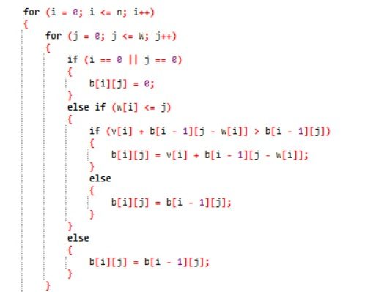
Code For Implementing Recursion Relations

Slide 10
BACKTRACKING
IF (t[I,j]!=t[i-1,j]) then mark the i th item
i=i-1 and j=j-wi
Else
i=i-1
CAPACITY , j
0 | 1 | 2 | 3 | 4 | 5
0
1
2
3
4
0 | 0 | 0 | 0 | 0 | 0
0 | 0 | 3 | 3 | 3 | 3
0 | 0 | 3 | 4 | 4 | 7
0 | 0 | 3 | 4 | 5 | 7
0 | 0 | 3 | 4 | 5 | 7
T[1,2]!=t[0,2] then select 1 move to t[0,0]
T[4,5]!=t[3,5] then select 2 move to t[1,2]
ITEMS , i
T[4,5]=t[3,5] then move to t[3,5]
T[4,5]=t[3,5] then move to t[3,5]

Slide 11
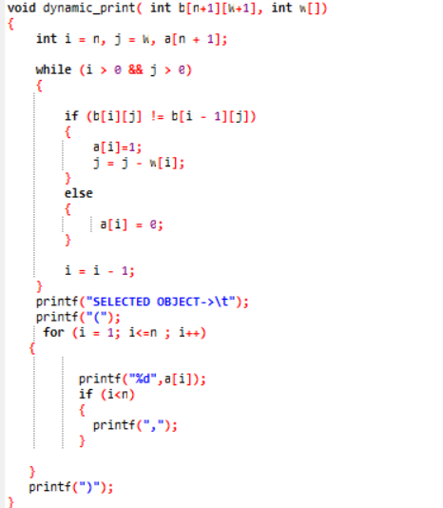
Code for implementing backtracking

Slide 12
FRACTIONAL KNAPSACK USING GREEDY ALGORITHM
STEP1:FIND Pi/Wi
Step 2:arrange Pi/Wi In Decreasing Order And Profit And Values Should Also Be Arranged Respectively
Step 3: FIND REMAINING WEIGHT AND CACULATE TOTAL PROFIT TILL REMAINING WEIGHT <=WEIGHT OF THE OBJECT
STEP 4: NOW TAKE THE WEIGHT REQUIRED FROM OBJECT AND PROFIT IS CALCULATED AS PROFIT=PROFIT+(REMWEIGHT/OBJECT Weight)*(pi OF THAT OBJECT)

Slide 13
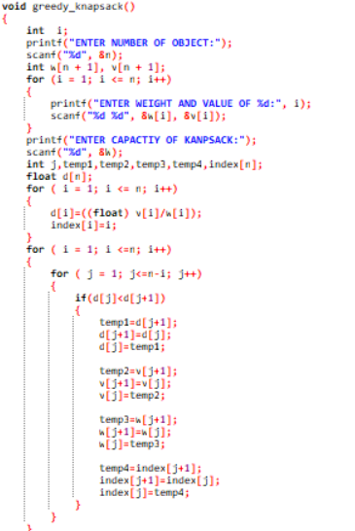
CODE FOR SORTING OF PI/WI

Slide 14
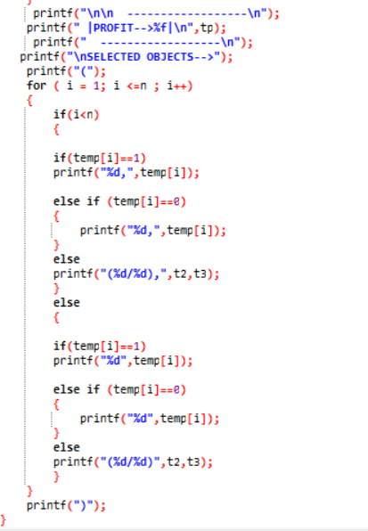
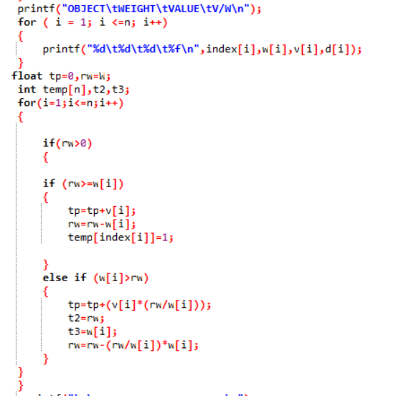
CODE FOR FINDING PROFIT AND ITEMS SELECTED

Slide 15
REAL LIFE APPLICATION OF KNAPSACK PROBLEM
RESOURCE MANAGEMENT IN SOFTWARE
CONTRUCTION AND SCORING OF TEST
SELECTION OF CAPITAL INVESTMENT
OPTIMIZE POWER ALLOCATION TO ELECTRIC APPLAINCES

Slide 16
THANK YOU

